Slide 1
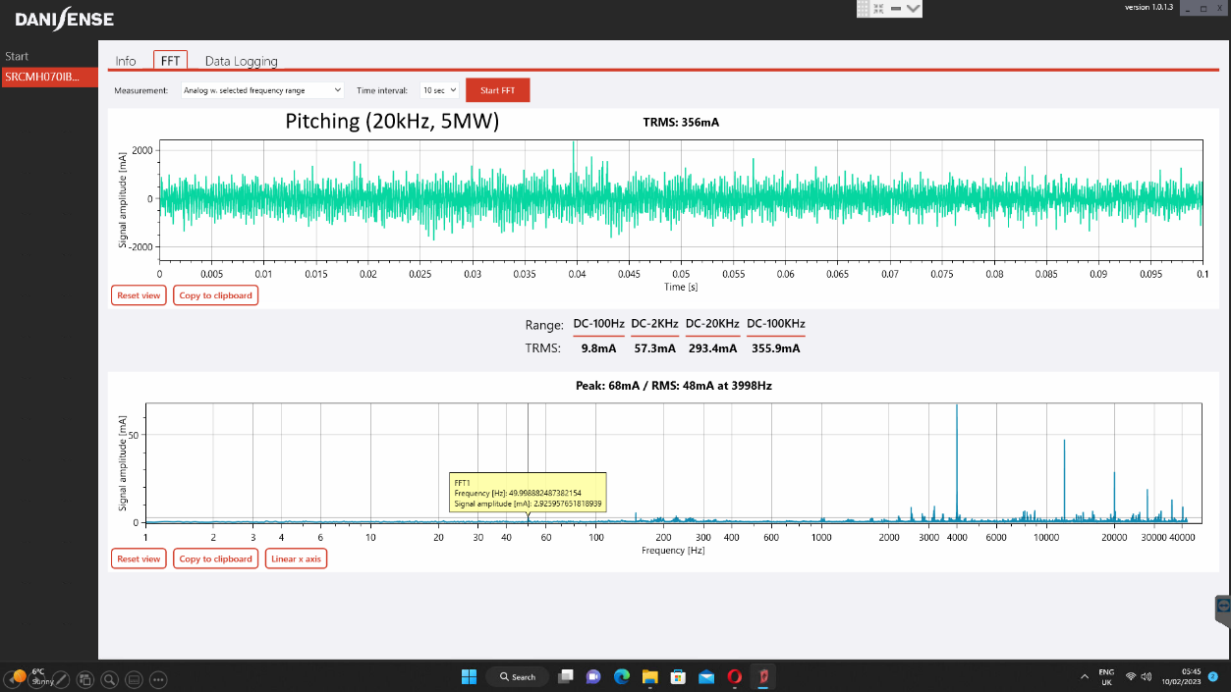
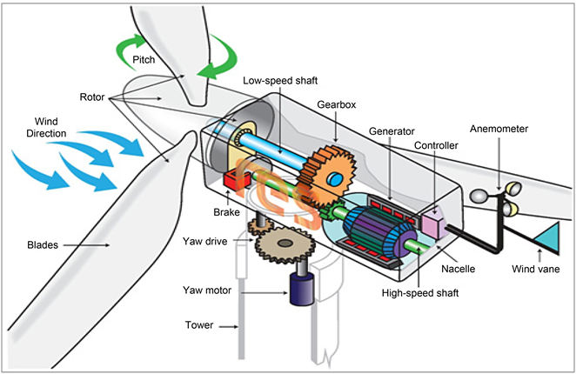
Residual Current Monitor
Ongoing Projets

Slide 2
Residual Current protective Device (RCD) vs. RCM
to the grid
to the grid
L1
L2
L3
N
PE
L1
L2
L3
N
PE
Circuit braker
Electromagnetic release
I >
Test button
Test button
Monitoring with evaluation unit
Summation current transformer
Summation current transformer
L1
L2
L3
N
L1
L2
L3
N
to the load
to the load

Slide 3
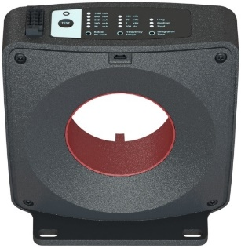
RCM in TN-S systems
Current sensors for energy measurement
By measuring the current in the central earthing point (CEP), the insulation of the entire system can be assessed.
PEN conductor from transformer
L1
R iso L1
L2
R iso L2
L3
CEP-measuring
The entire leakage current of the system flows here.
R iso L3
N
R iso N
I_{res ∑}
PE
I_{res ∑}
I_{res C1}
I_{res C2}
Measurement processing
Universal Measurement Device:
1 x 4-Phase-Voltage Measurement
X x inputs for current measurements (Energy measurement)
X x inputs for residual current measurements
R iso C1
R iso C2
Load 1 with frequency converter / switched-mode power supply
R iso C1
Load 2 with frequency converter / switched-mode power supply
R iso C2

Slide 4
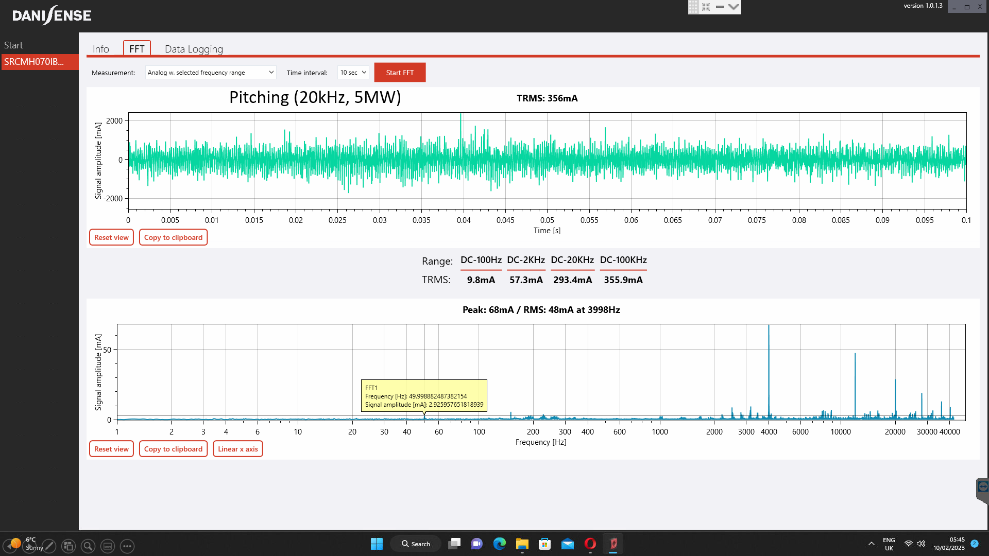
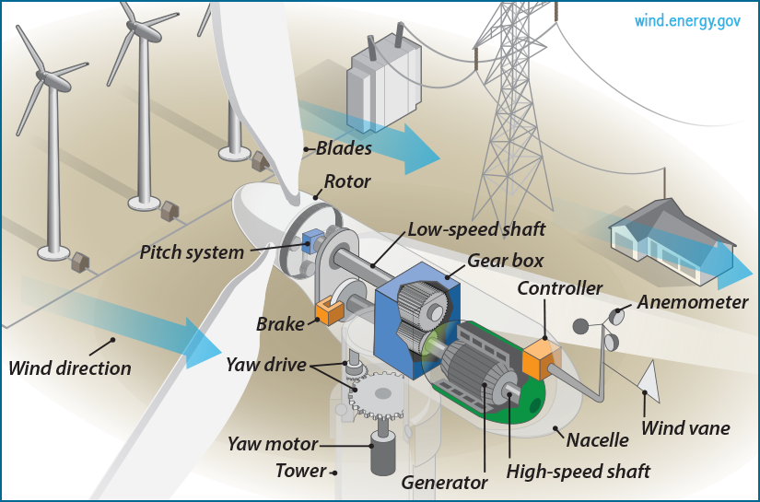
GE 5 MW Wind Energy Plant
Pitch system
Turns blades out of the wind to control rotor speed. Also, stops the rotor from spinning in conditions where wind blowing too slow or too fast

Slide 5
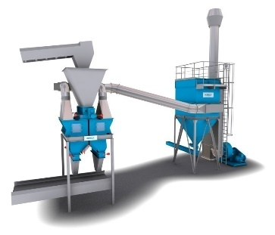
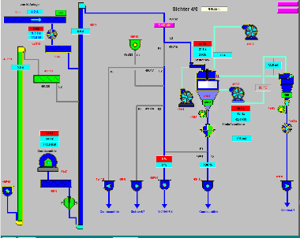
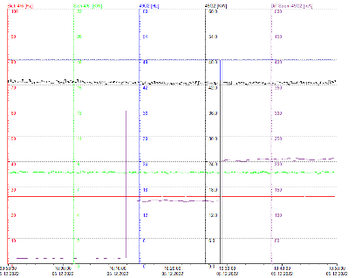
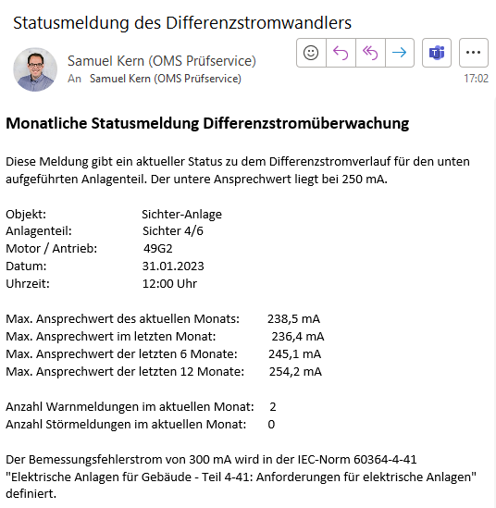
SRCMH070IB+
Master thesis in cooperation with Beckhoff Automation
Energy Residual Current
gravel plant separator

Slide 6
Monitoring using 4-20 mA output (1000 ms)
Due to the integration interval over 1000 ms, the current peaks during switch-on and switch-off processes are smoothed, so that no clearly increased values are recognizable via the TRMS calculation.

Slide 7
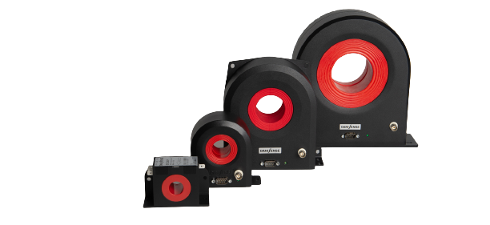
Permitted residual current levels of equipment
Laboratory Measurements
In international standardization, the standard IEC 61140:2016 under point 7.6.3.3 defines the maximum levels of current on the protective earth conductor of equipment and loads in normal operation up to 1 kHz.
IEC 61140, Revision 4.0, January 2016 - Protection against electric shock – Common aspects for installations and equipment
Since DC residual currents can also occur in many loads such as frequency converters, there is the following version to read under 7.6.3.4.
…In normal use, a.c. current using equipment shall not generate current with a d.c. component in the protective conductor that exceeds the values in in following table. This will prevent affecting the proper functioning of protective device(s) or other equipment in the installation. …
Maximum levels of current on the protective earth conductor of equipment and loads in normal operation up to 1 kHz
Rated current of current-using equipment a.c. | Maximum protective conductor current for frequencies up to 1 kHz
0 < I ≤ 2 A | 1 mA
2 A < I ≤ 20 A | 2.5 mA/A
I > 20 A | 10 mA
Rated current of current-using equipment a.c. | Maximum protective conductor current d.c.
0 < I ≤ 2 A | 5 mA
2 A < I ≤ 20 A | 2.5 mA/A
I > 20 A | 50 mA

Slide 8
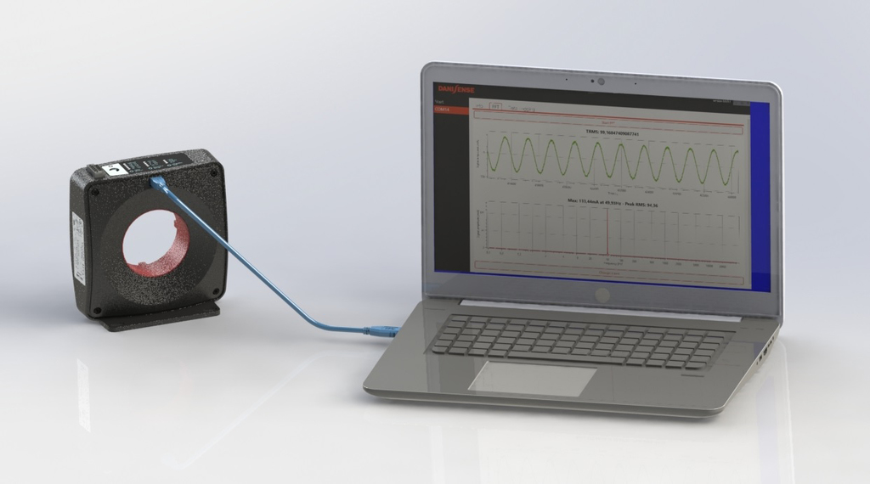
Just a question!
Do you have type A RCDs at your facility?
Do you need type B?
Check it out! You have only one life!

Slide 9
Thank You

